Slide 1
Mobility as a Service
End user perspectives and challenges
Marko Javornik
VP/GM Mobility & Travel

Slide 2
COMTRADE DIGITAL SERVICES
The New Digital Economy
Hotels
Commerce
News
Travel
Mobility
Airbnb: Employees: ~3,100 Valuation: $29,3B
Hilton Worldwide: Employees: >300.000 Valuation: $19,8B
Alibaba: Employees: 50,100 Valuation: $360B
Wal-Mart: Employees: 2,200,000 Valuation: $212,4B
Facebook: Employees: 20,700 Valuation: $408,6B
The New York Times: Employees: 3,700 Valuation: $3,0B
Google Travel: Employees: ~10,000 Valuation: $100B
Lufthansa: Employees: 120,300 Valuation: $10,8B
Didi: Employees: 7,600 Valuation: $50B
Opel: Employees: 34,300 Valuation: $2,3B

Slide 3



About Comtrade Digital Services
1500+ Employees
300M+ Revenues
30 Strategic partnerships
Ryanair
Itron
Pay Safe
100M+ yearly passengers
~100M Smart & connected meters
600 banks
140K+ members
40M users

Slide 4

COMTRADE DIGITAL SERVICES
Comtrade Digital Transportation Lab

Slide 5
COMTRADE DIGITAL SERVICES
Challenges of Mobility Today
01. Low Utilization
03. Environmental Footprint
01. Lack of focus
on individual needs
02. Missing first and last mile
02. Congestion
04. Does not scale

Slide 6
COMTRADE DIGITAL SERVICES
End Game Scenario
Mobility as
a Service
Shared
Electric
Autonomous

Slide 7

COMTRADE DIGITAL SERVICES
User Perspective
User Experience
Factors in MaaS
Application
Usability
Smoothness
of Travelling
Innovativeness
of the Service
Responsibility
• Easy access to „human support“ If needed
• Provision of real-time information
• Capability to monitor changes throughout the journey
• Proactive communication & interaction between operators and users
• Solicitation of “social feedback” channels
• Removal of existing “pain points” of traveling
• Integration & connectivity of services
• Seamless and safe physical space
• Use of bonuses and rewards
• Development and application of innovative business models and financing mechanisms • Enabling the end user to also be a provider (encouragement to shared and peer-to-peer mobility)
• Social inclusion and accessibility • Incentives to environmentally beneficial actions

Slide 8
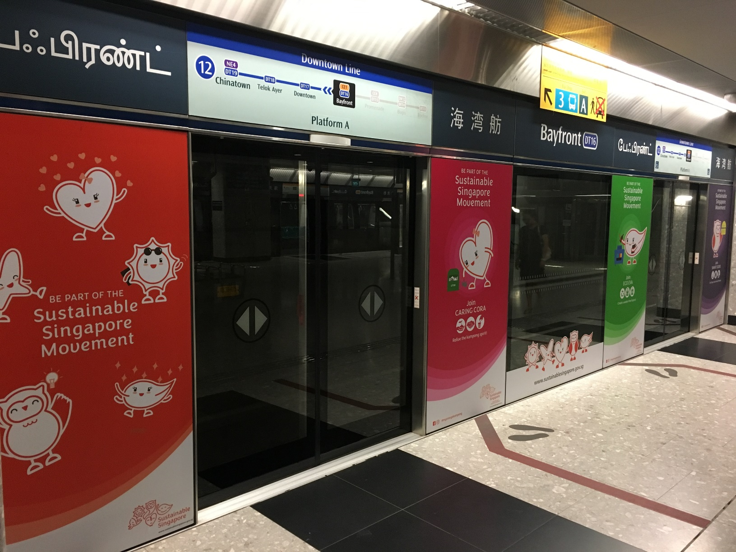
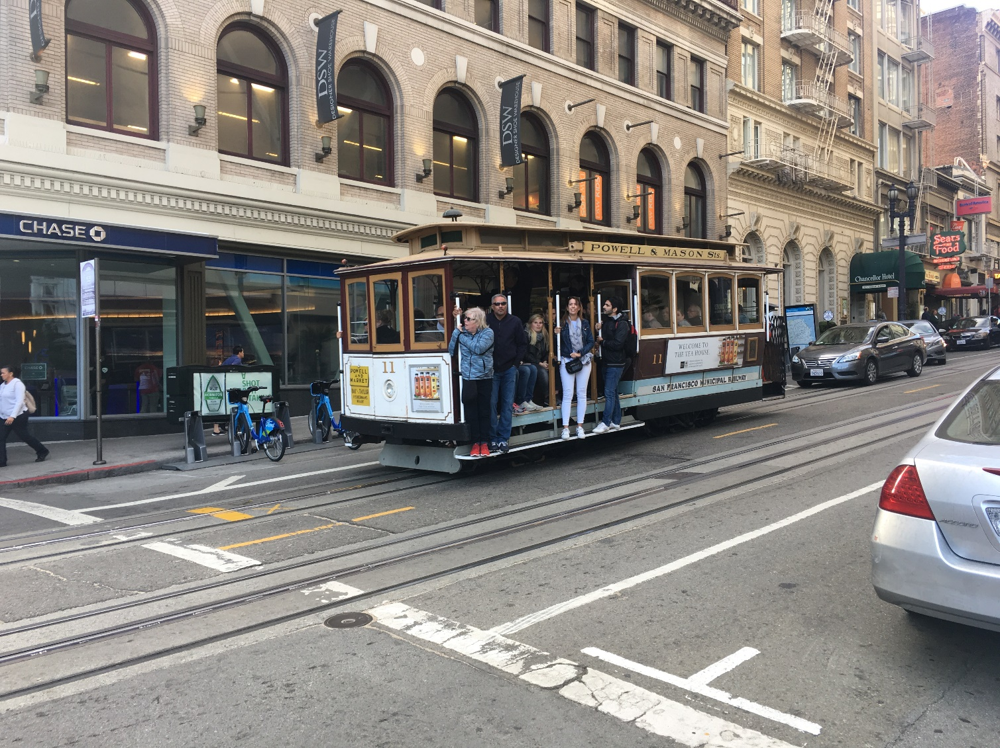
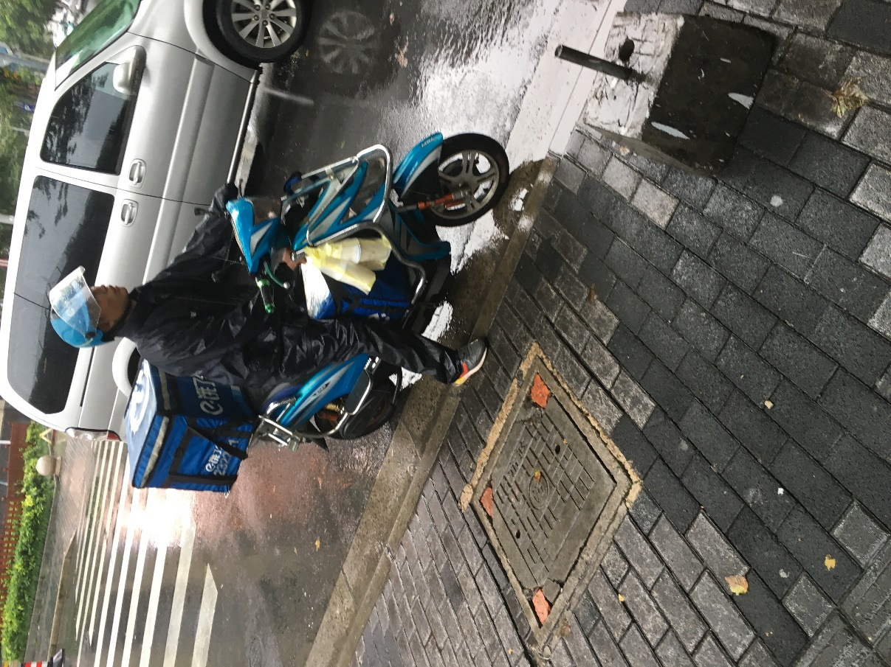
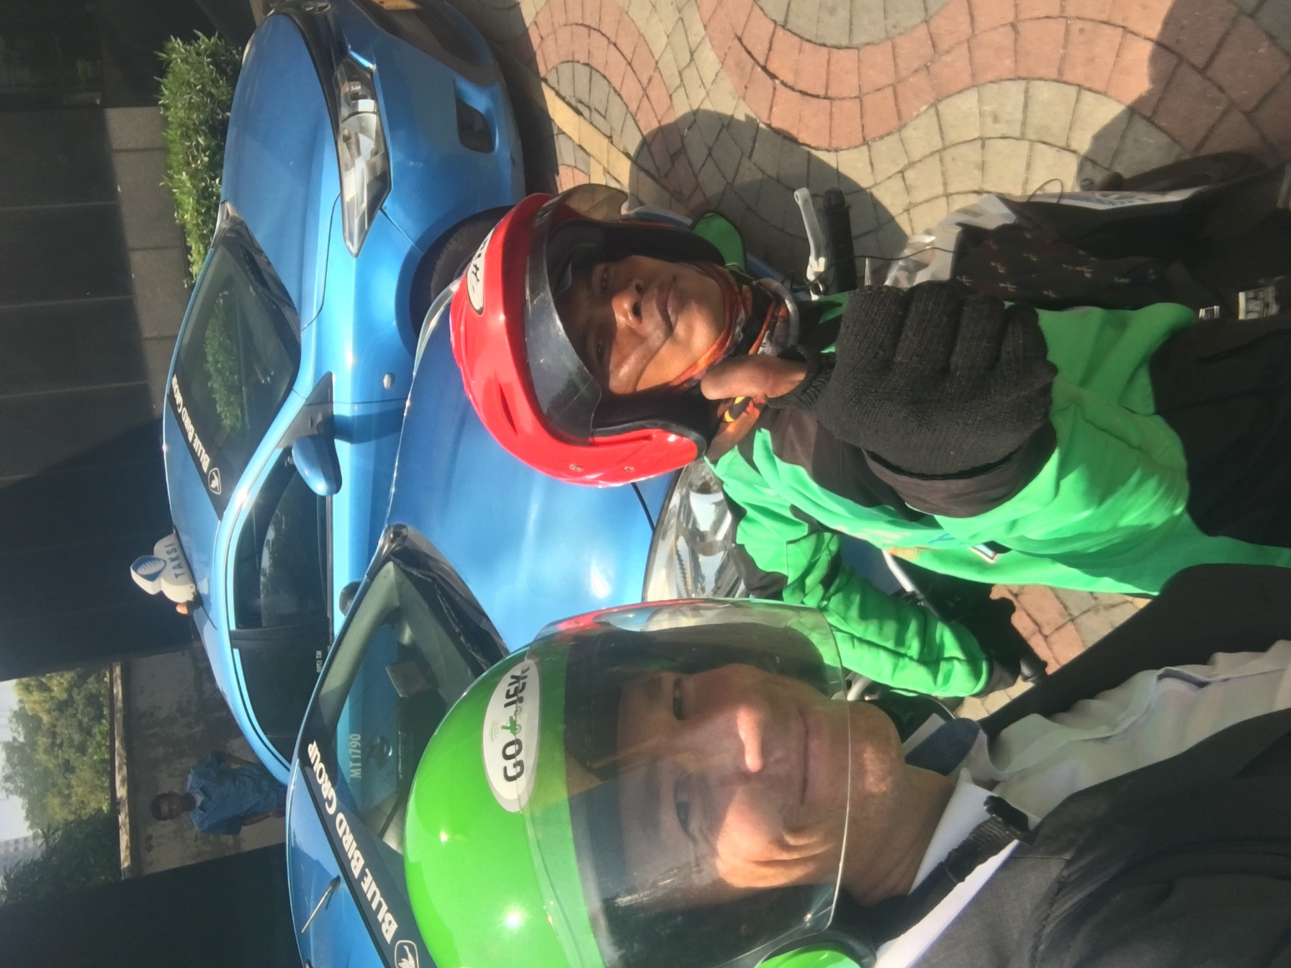
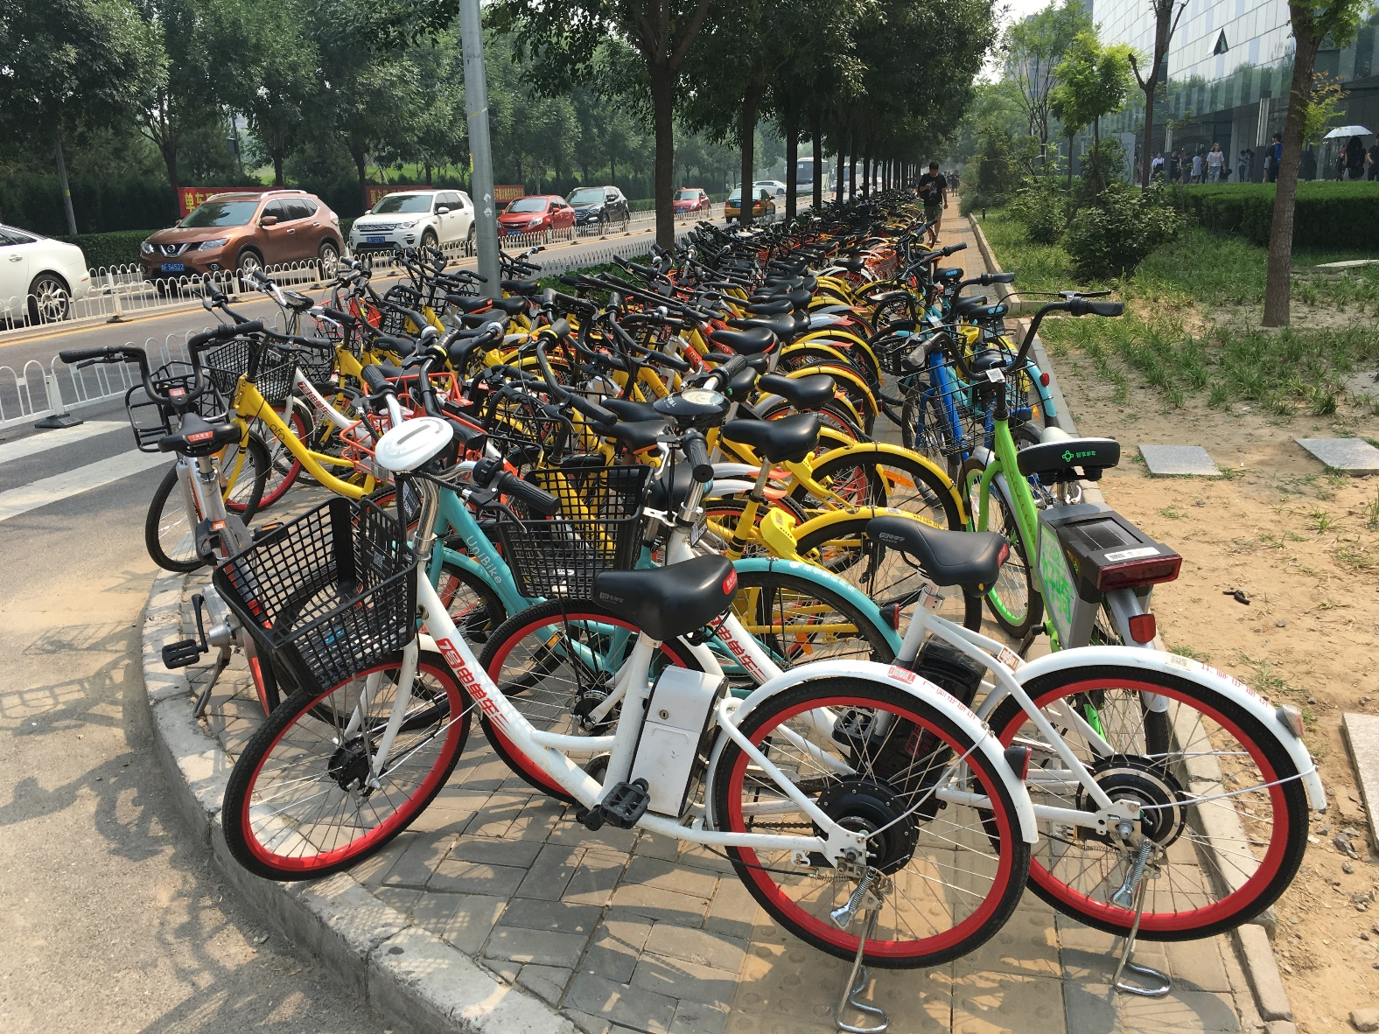
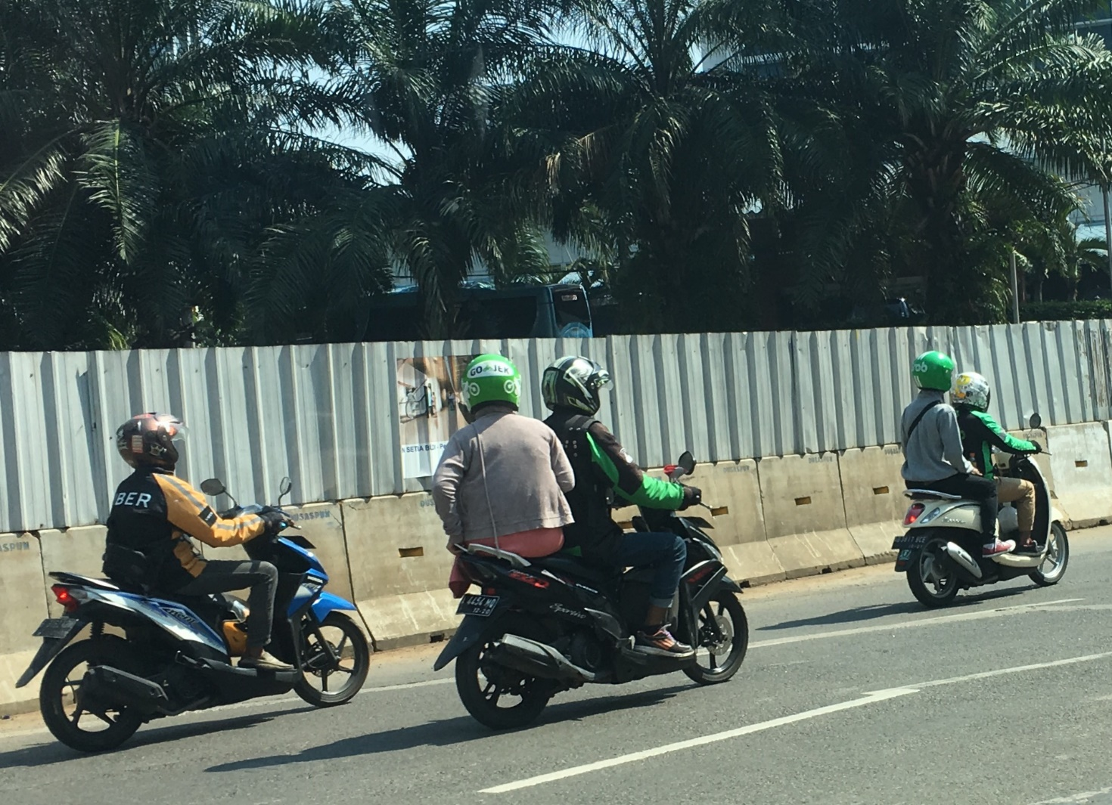
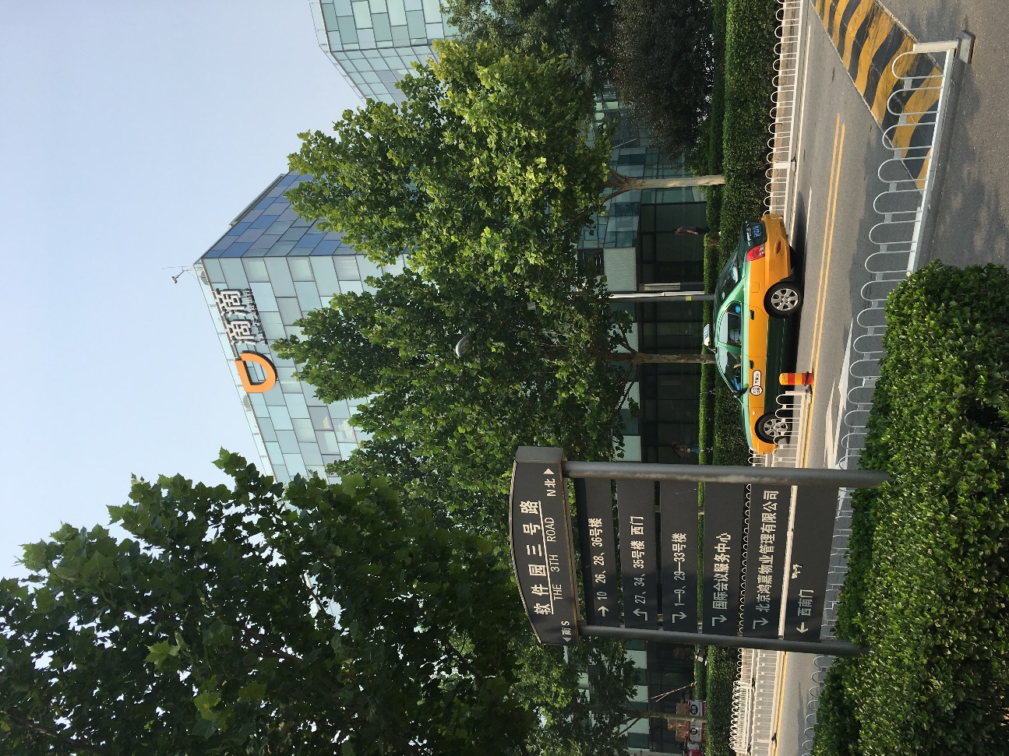
COMTRADE DIGITAL SERVICES
Personal Experience

Slide 9








SEAMLESS
MOBILITY
DATA
SUBSCRIPTION
INTEGRATED
MOBILITY
PAY PER USE
USER CENTRIC
MOBILITY
ON-DEMAND

Slide 10
Comtrade Digital Services
Three possibilities for markets to evolve
Winner
takes it all
Public transportation
takes it all
Roaming ecosystem
Mobility as
a Service
(aggregators)
private
car
bike
sharing
Transportation
providers
private
car
private
car
tram
bike
sharing
bike
sharing
bus
tram
tram
train
bus
bus
car rental
train
taxi
train
taxi sharing
car rental
car rental

Slide 11
COMTRADE DIGITAL SERVICES
Challenge of Digital Platform Economy
THE
WINNER
TAKES IT ALL
Alibaba
GOOGLE
UBER
Didi
Facebook
AMAZON
NETFLIX
TripAdvisor
Skyscanner
Airbnb
WeChat
Grab
Booking.com
Ofo
Baidu
Expedia
SPOTIFY
Snapchat
drivenow
Flixbus
LinkedIn
Whim
car2go
mytaxi
Instagram
moovel
Supply
Demand
Notes:
Please rebuild CLOUDS and TROPHY into GREEN colours

Slide 12




COMTRADE DIGITAL SERVICES
Conclusion
Digital API economy is here...
...also for ground mobility
It brings tremendous innovation & benefits
It also brings new challenges.

Slide 13
Marko.Javornik@comtrade.com

